Slide 1
FUNDING SUCCESS
Value for Effort
Sally West Baseball Queensland

Slide 2
Have you ever applied for a grant?

Slide 3
Why do we need grants?
Relatively easy way to access large amounts of money
Provides funds over and above regular income

Slide 4
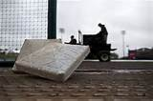
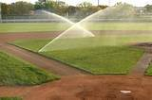
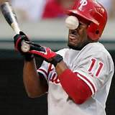
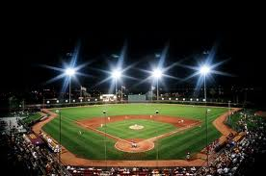
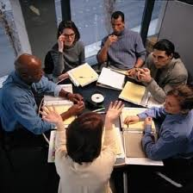
How much does it cost to run your sport or activity?

Slide 5
From where is our income derived?
Membership
Sponsorship
Canteen
Donations
Facility rental
GRANTS

Slide 6
What can we get funding for?
Just about ANYTHING!!
Infrastructure – new and upgrades
Equipment
Education and Training
Participation Programs
Volunteer Recognition
Special Events
Athlete Assistance

Slide 7
Infrastructure
Lights
Field surfaces
Pitches
Courts
Fencing / backnets
Dugouts
Irrigation systems
Goal boxes / posts
Storage sheds
Grandstands
Clubhouses
Change rooms
Toilets / showers
Swimming pools

Slide 8
Equipment
Balls
Bats
Helmets
Gloves
Catchers’ gear
Umpires’ gear
Tees
Pitching machines
BBQs
Mowers
Landscaping equipment
Line markers
Canteen equipment
Bases
Sunscreen
Cleaning products
Computers and software

Slide 9
Education and Training
Committee governance training
First Aid
Risk Management
Financial management
MYOB
Volunteer Management
Marketing
Officials’ training and accreditation courses
Conflict management
Groundskeeper course
Food preparation and service
Cultural awareness
Website design

Slide 10
Participation Programs
Come and Try Days
School to Club link program
Sports Expos
Target group initiatives
Specialist clinics
After-school or vacation programs
New competitions
Gala Days

Slide 11
Volunteer Recognition
Fuel vouchers
Club shirts
Volunteer functions

Slide 12
Special Events
Tournaments
Camps
Visiting teams
Exhibition games
Grand Finals Days

Slide 13
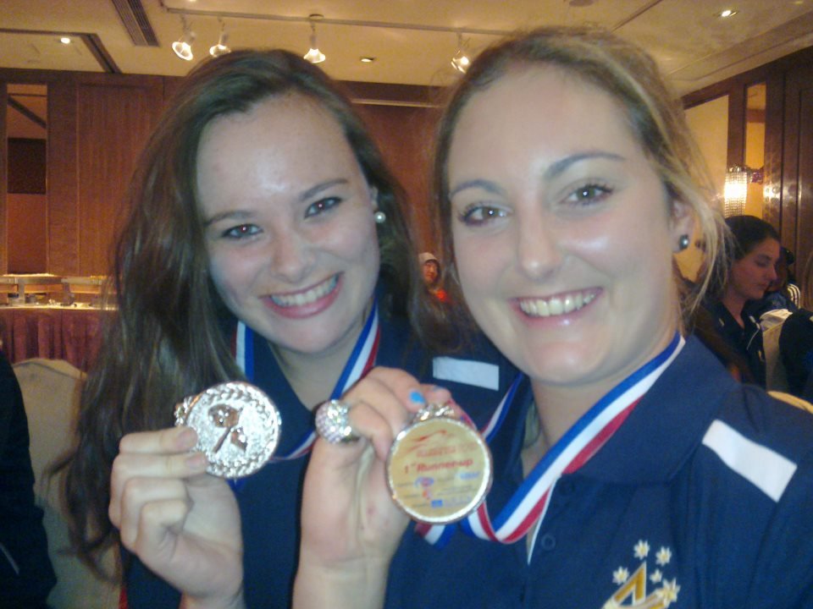
Athlete Assistance
Teams
Individuals

Slide 14
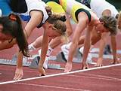
Where do we start?
Establish needs
Strategic Planning
Prioritise
Approximate cost
Timeline
Consult with committee and other stakeholders.
Set up a grants team (Harder with one person)
Scope the project
Identify potential funding sources

Slide 15
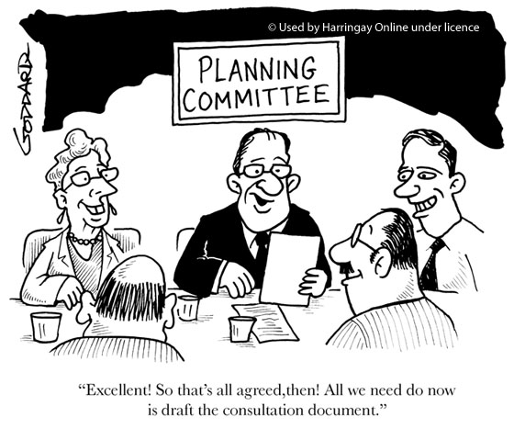
Planning / Scope
Identify the need for the project
What is the expected outcome?
What assistance can you get?
Who will you work with?
What resources do you already have?
Who will benefit? … think outside the square
Find a grant that matches your project… not the reverse.

Slide 16
Where do we look?
The Internet
Federal Government
GRANTSLink grants.myregion.gov.au
State Government
Dept NPRS&R; OLGR grants (GCBF, Jupiters)
Local Government
Check if your club crosses over more than one Local Govt area

Slide 17
Where do we look?
State or National bodies
User Pays Services
www.grantsearch.com.au
www.ourcommunity.com.au
www.grants.gov.com.au
Register for funding email alerts
NPRS&R, Council Sport and Recs,
Partner with a grants consultant

Slide 18
Where else can we look?
Philanthropic Trusts and Foundations
Myer Foundation; Mantana Foundation
Businesses with Community Benefit Funds
McDonalds; Suncorp; RACQ; NRMA
Not for profit organisations
RSLs; Licensed clubs; Leagues Clubs

Slide 19
Funding Cycles
Many funding programs are offered annually
BCC this year
Some have several rounds per year
GCBF; Jupiters
Some will resubmit unsuccessful applications for a second chance
Being aware of funding cycles assists with strategic planning

Slide 20
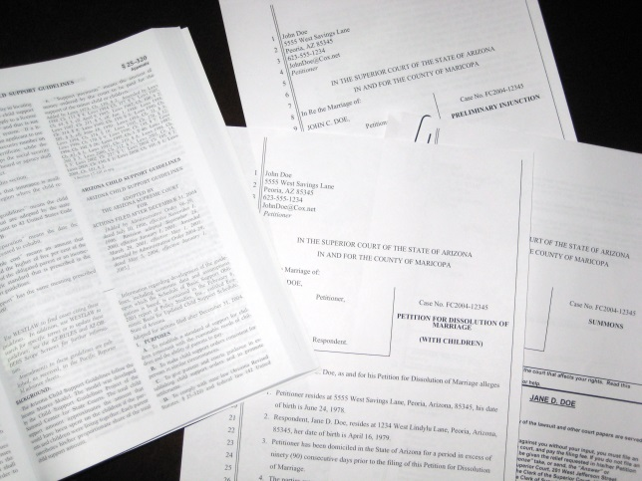
How to be “Grant Ready”
Maintain a “Grant Ready” checklist
Have easily accessible copies of frequently requested documentation
Certificate of Incorporation
Constitution
Most recent audited financial statements
Proof of tenure
Up to date membership details

Slide 21
Grant Ready Checklist
ABN
Incorporation Number
Date of Incorporation
Incorporation status
Bank account details
GST status
Date registered for GST
Full legal name
Street address
Real property description
Postal address
Tenure agreement
Club accountable officer and contact details
Contact person and contact details
Brief description of the organisation, its history, location and core business
Land owners’ permission

Slide 22
Next….
Identify the appropriate grant
Thoroughly review a copy of the funding guidelines.
Contact the funding provider to confirm that your project meets the guidelines and seek feedback for your proposal.
Begin gathering requested documentation.

Slide 23
Guidelines …. Most important!
Objectives and description of the grant
Eligibility criteria
Important dates
Funding categories
Assessment criteria
Obligations if successful
Lodgement information
Contact details

Slide 24
Writing the Application
Answer each question fully but succinctly.
Support answers with research and documentation. Add attachments if needed and able, and reference them.
Keep the presentation simple. No superfluous supporting material.
Refer back to the funding guidelines and assessment criteria regularly to answer each question.

Slide 25
Writing the Application
Presume that the assessor knows nothing about your sport or activity.
Assume the assessor does not know acronyms.
Use key words referred to in the guidelines or other department literature.
Be specific. Ie “The project will benefit 100 children aged 5 to 8 years” rather than “The project will benefit a large number of children”.
What is the point of difference of your project? Add value.

Slide 26
Presentation
Simple and consistent formatting.
Informative headings to break up the text.
White space.
Bullet points.
Include relevant photos, maps or diagrams.
Organise appendices with a contents page and page numbers (perhaps a coloured page).
Do not bind unless specified.
If a template is provided, do not change it. Keep headings, tables and layout as provided.

Slide 27
Content
Project descriptions.
Often word limited.
Needs to include who, what, when and why.
Use key words in the guidelines, stress outcomes and benefits to the community.

Slide 28
Content
Substantiating need.
Background to the project.
How did you identify the need?
Attach supporting documents (eg ABS stats, research), letters of support relevant to project only. Show community consultation.

Slide 29
Content
Provide a cover page or letter.
Get someone else to proof read. Sometimes the fund providers will give feedback before submission (eg Dept NPRS&R).
Check how many copies are required. Keep a copy of everything for yourself, including supporting documents.
Check the checklist.

Slide 30
After your success…
Read the funding agreement and make sure you understand all aspects.
Funding agreement is a legal contract.
Acknowledgement - follow guidelines and deliver as promised. Keep records for acquittal.
Understand the acquittal requirements before you commence the project.
If changes need to be made, ask for permission from funding provider.
Account the grant separate from other business.
Celebrate!!

Slide 31
My good luck so far…
More than $750 000 (over $200 000 in last two years)
State Government Sport and Rec grants for:
infrastructure (baseball backnets, fencing, dugouts, lighting),
education (officials’ training, committee governance workshops, first aid)
equipment (portable infrastructure, baseball equipment)
club promotions (flyers, banners, signs)
Athlete assistance

Slide 32
So far ….
Federal Government
Volunteer Grants
Volunteer equipment - BBQs, mowers, grounds equipment, AV equipment, IT equipment, software, furniture, work station
Athlete assistance – Local Sporting Champions

Slide 33
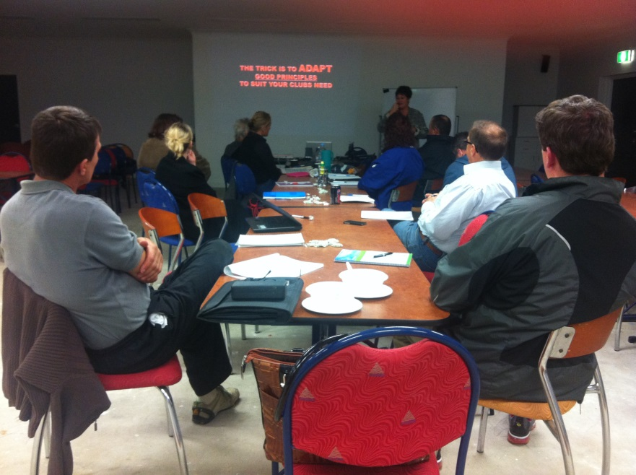
So far….
Local Government
Infrastructure - fencing, lighting, field maintenance MBRC
Training - Governance workshops and assistance BCC
Strategic Plans MBRC
Event funding MBRC
Athlete assistance MBRC

Slide 34
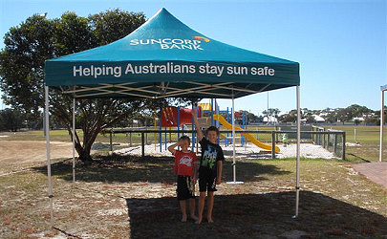
…….
GCBF
Ride-on mower, IT equipment
Suncorp Sunwise
Shade shelter
Woolworths Community Grants
Junior equipment

Slide 35
Acknowledgements
“Tapping the Money Tree”
Miriam Martin
“Grant Writing”
CPR Group, Steve Connelly
“Writing Funding Submissions”
Qld Dept NPRS&R – North Coast Region

