Slide 1
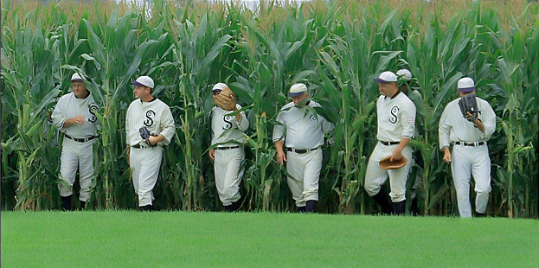
“Build it and they will come”
Increasing club membership

Slide 2
Why do we need to increase membership?
Increased player talent pool
Increased revenue - player fees
- sponsorship potential
- event profit
- more likely to get grants
Increased number of potential volunteers
Decreased cost to each member for set costs such as facility maintenance, admin costs etc.
Club has a financially viable future.

Slide 3
Where are we going?
Club Vision and Strategic Plan
Successful clubs have a vision of what they want their club to be – who and what the club is for and what they are trying to achieve. They want to look after current members and future members, and they have planned how to increase participation and membership.
Membership initiatives should be identified in the Club Strategic Plan.

Slide 4
“Welcome to our club”…
Make new members feel welcome.
Studies show that a healthy, welcoming environment at a sports club can significantly increase potential membership. Successful customer based businesses all recognise the need to be welcoming to their clients (McDonalds, Hogs Breathe Café, Woolies)
Make sure the person whose contact details are on club promotions is friendly, welcoming and has all relevant information. They must be the club’s salesperson.

Slide 5
Recruitment
Complete the Aussie T-Ball planner sent to the club pre-season each year. It contains a template for a marketing and recruitment program for your club. These strategies are then used in conjunction with the Baseball Qld school recruitment program.

Slide 6
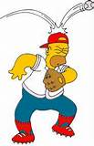
Try before you buy….
Run a ‘Come and Try’ day — this allows your club to provide a quick taste of your sport. These can be held in conjunction with AASC program providers or local schools, but need to be promoted widely and it is important that people are then able to immediately join a club or start a competitive season.
For more information on running a “Come and Try Day” see other article on this page of website.

Slide 7
What will it cost??
Don’t price yourself out of the market but … don’t devalue your membership.
Calculate player fees to accurately reflect the real costs of running the club and providing a quality experience. Show members the breakdown and remember to include money for a “sinking” fund for ongoing maintenance.
Give members the option to pay the premium fee or to reduce the fee by volunteering in some capacity.
Members are prepared to pay for quality.

Slide 8
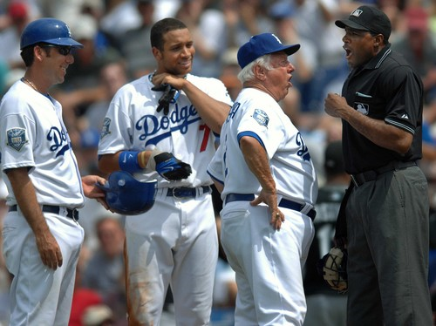
What do I get for my money?
Since club members will only keep coming back if they are enjoying what they are doing, it is important that accredited, experienced coaches and officials are delivering activities. Encourage club volunteers to undertake appropriate training and recognise their achievements along with players.

Slide 9
What do they want?
Be flexible to your members’ needs.
If your club has declining membership, it might be time to listen to what members and potential members want and start providing it. One way to achieve this is through a survey of current and potential members.
It may mean changing how and when a sport is played.

Slide 10
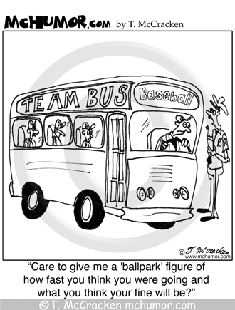
Is it easy to get to?
Make your fixtures, training, and events easily accessible. If distances have to be travelled, consider including a transport option in the membership fees.
Run Aussie T-Ball and Rookie Ball in-house once you increase the numbers.

Slide 11
AASC
The Active After-school Communities (AASC) program provides primary school children with access to sport and structured physical activity after school. It runs in more than 3200 schools and after-school centres across Australia.
As a club, you can link with the AASC program in many ways. For example, you can run activity sessions in your sport at AASC sites. Research shows children involved in AASC activities are often motivated to join a sports club.

Slide 12
Become a community hub
Your club should have a strong community presence so people are aware of what you have to offer. You can raise awareness by promoting fundraisers, writing articles for local newspapers or running clinics at schools. Engage with other groups in the community… fun events, fundraisers etc.

Slide 13
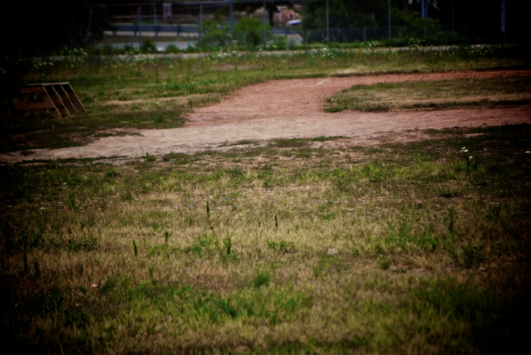
Keep it clean!
Facility maintenance is extremely important. Keep grass mowed, weeds down, paint jobs up to date, toilets clean etc.
The parent of a potential member will be less than impressed if their first impression of the club is one of general neglect.

Slide 14
Volunteer Rewards
Any club serious about building membership will need to have enough volunteers to cope with the increased workload. You should have plans in place to recruit volunteers, assign their roles, ensure they are not overloaded and to recognise and reward their input.
Build a volunteer reward scheme into the calculation of player fees to encourage volunteering within the club.

Slide 15
Fun, fun, fun…
Make sure that your club is “not just about the sport”.
Run social and novelty events throughout the season and off-season. Keeping in touch with people in the off-season will encourage them to return.

Slide 16
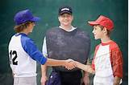
Positive or it’s pointless….
Develop a positive behaviour plan for your club members and supporters. Ensure that all members and supporters agree to abide by club codes of conduct as a part of their membership application.
Adopt programs such at the Qld Govt POIP.

Slide 17
Don’t spoil the fun for others…
Many sports/clubs lose members or potential members because of bad behaviour by players or spectators. Club officials must insist on acceptable behaviour at all times. This will change depending on the clients present at the time.
Control alcohol consumption….many people leave clubs because of the poor behaviour of a few intoxicated people. Join the Good Sports Program. Make sure all canteen staff serving alcohol have an RSA certificate and abide by the licensing regulations.

Slide 18
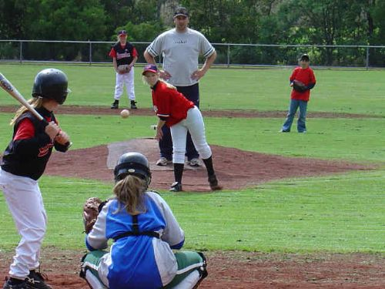
Ask the girls…
50% of your potential members in the community are female but only a small percentage of the current Baseball Qld player base is female.
ATB … 20%, Rookie Ball and Little League 13%, U14, 16 and 18s 10%, Seniors and Masters 3%
Clubs that are growing are targeting girls. BQ has a Girls’ and Womens’ Development Program to offer those players a representative pathway.

Slide 19
Spread the word…
Promotion of your club out in the community is paramount to increasing membership. Good marketing involves a multi-faceted approach and money needs to be set aside in each annual budget for promotional activities. Grants are also sometimes available to assist with these costs. For more information, see our presentation, “Raising your club profile”.

Slide 20
Where did we find this out?
Thanks to the following sources of information….
Australian Sports Commission
www.ausport.gov.au
Sport England
Good Sports
NZ Orienteering Federation 2000
Sports Marketing Workshop 2009
“Grow your Sports Club” Svend Elkjaer

