Slide 1
Raising your Club’s Profile
Marketing and Promotion

Slide 2
What is Marketing?
When you mention marketing to many people, they instantly think of activities such as advertising, flyers, brochures and direct mail.
However it encompasses much more than this, and many of the things that you’re already doing could be classed as marketing.

Slide 3
Informal marketing
Are you aware of how people are treated when they enquire about joining your club, or whether new members are made to feel welcome?
If you are, then you are currently undertaking what is called ‘informal marketing’ and this is vital for the sustainability of your club.

Slide 4
Formal marketing
Formal marketing consists of what is called the marketing mix and is most commonly represented through elements that relate to product, price, place and promotion. The first three of these focus on whether your product or service fits the needs of your existing and potential customers or members.
Promotion relates to how you communicate and publicise what you have to offer.

Slide 5
Why use marketing?
In order to survive and grow in an increasingly competitive market, baseball clubs must find ways of attracting new members while retaining existing ones.
Marketing also helps you:
Identify opportunities for growth and long term sustainability;
Clearly communicate and raise awareness of exactly what your club has to offer;
Become more visible and a hub within the community;
Increase sponsorship and engage local businesses;
Recruit volunteers.

Slide 6
Who does the marketing?
Everyone in your club should be involved in informal marketing whenever they can. Encourage your members to tell their friends and family about what you do and what your club can offer.
For the formal marketing side of things, it’s particularly useful to appoint a marketing and promotions officer, or small team to oversee the development and implementation of your club’s marketing strategies.

Slide 7
How to market your club
Understand what people want
People don’t like being told what to do and when to do it.
Marketing is about looking at sport from the point of view of the individual, and learning to understand what he/she wants from it and how these needs can be met.
Think about what barriers there are for people joining your club. Is it lack of time, the cost of membership or the fact that people consider alternative activities more fun?

Slide 8
How to market your club
Make sport fun, easy and popular
Activities that involve spending time with friends and family are very appealing to people.
Emphasise the social side of playing and how much fun it can be being part of a team or playing sport with your family.
Most people accept that playing sport is a lot more fun when it’s sociable, and because of this, more people are likely to take part.

Slide 9
How to market your club …
Tips
Keep it simple and utilise the full range of tools that are available, from using the media to running events.
Select the tools that will best reach the people you want to encourage to join your club. When promoting sport, it is important to use images that people can relate to, so they feel included from the start.

Slide 10
How to market your club
Tips
And finally, don’t forget to make the most of the technology that is available. Your website, social media and email campaigns are effective, low cost and immediate ways of communicating to existing and potential members.
Develop a “brand” using a logo and use that brand on every promotional item you use. Brand recognition is powerful.

Slide 11
How to raise the profile of your club …
Before you start selecting the most appropriate marketing tools to use to grow your sports club, you need to think about the following:
What are your club’s values?
What are your club’s unique selling points?
What sort of people do you want joining your club?
What key message do you want to include in your promotional material?
Are your membership fees realistic and competitive?
How do people find you?
What do you hope to achieve from marketing?

Slide 12
Club values
Your club’s values or ‘personality’ are the things that will attract people (or put them off) joining your club.
A sports club should include values such as fun, safe, social and professional. These values need to be expressed in everything your club does, from writing letters to how a coach interacts with his/her team.

Slide 13
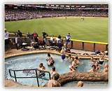
Unique selling points…
Think about the quality of your service and ways that you can improve it.
What feedback have you received from members?
Make sure to promote any quality assurance schemes you have achieved such as Good Sports Level, ABF Baseball Club of the Year.
What has your club got that others haven’t?

Slide 14
Who do you want?
Think about the people who live in your local area. Is there a large number of a certain age group or are there are lot of young families?
Do you want to increase the number of junior or senior teams?
How can you accommodate or target these groups with what you offer?
ie If you have a large number of very young families in your area, you will focus recruitment on Aussie Tball but a large Baby Boomer population would be open to a Masters competition.

Slide 15
What is the message?
What one thing would you want to get across to the public?
What aspect of your club do you feel is particularly strong?
Is it the number of teams you have, their successes in the sport, your great facilities or maybe the social aspects and the friendly atmosphere within the club?

Slide 16
Competitive fees?
Can people realistically afford your membership?
Is this proving a barrier for some people joining your club?
Are you competitive with clubs who offer a similar service? If not, tell people what you are offering on top of what others offer.

Slide 17
How do people find you?
Are you easy to find on Google, Facebook?
Do you have something positive on You Tube under your club’s name, sport or region? (You Tube is one of the biggest search engines in the world.)
Check with your Local Council to make sure your club’s details are included on their online directories.
Check that your club details are up to date on MyClub. These details are what people see when they search for a local club on the ABF and BQ websites.
Ensure that you are listed within local directories including the white and yellow pages.

Slide 18
What do you want your marketing to achieve?
Outline the specific goals that you want to achieve from marketing.
“I want 20 new members to join our club as a result of the open day we are running. Because it’s likely that only 25 percent of those attending the open day will join, we need 80 people to attend”.
Going into this much detail will help you decide how many people you will need to target and the marketing tools to use to achieve this.

Slide 19
Marketing Tools
Social media - Facebook, Twitter, YouTube, LinkedIn, Pinterest
Website
Flyers or advertisements
Local media
Signs and banners
Direct mailouts

Slide 20
Social media
FACEBOOK
There are over 1.06 billion people on Facebook worldwide. 618 million of them log on each day (Dec 2012).
5 new Facebook profiles are made every second.
300 million photos are uploaded every day.
Highest users are aged 25-34 yrs.
50% of 18-24 yr olds check their Facebook when they wake up.

Slide 21
Social media….
Your club should have an official Facebook page. This is a great way to communicate to current members but an even better way to market to all of their Facebook friends about your club. The administrators of the page should keep it up to date with fresh, exciting and interesting stories about all facets of the club….not just the sport side of things.

Slide 22
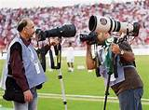
Social media …
Adding photos makes the page more lively. Make sure you have people sign a permission form for the use of their image or that of their child at the beginning of the season.
Facebook advertising is an economical way of advertising to rival the traditional pre-season “ad in the paper”.

Slide 23
Social media…
Another very popular social medium. Clubs can build a profile page, update scores and events as they happen, link to the website and Facebook page. Tweets need to be regular.
Over 2 billion views of You Tube videos every day.
Average person spends 15 minutes per day on You Tube.
Make it positive and direct viewers to another site such as Facebook or website. Expose your brand.

Slide 24
Website
Websites, in recent years, have become a lot more than just a method to electronically display information about your club.
An interactive website will allow the public to register for courses or pay their membership fees online, thus saving you time and money with administration. This also allows you to capture valuable information about the people who are visiting your site.
Websites are at the heart of most successful marketing campaigns. By promoting website addresses on marketing material, you are able to direct people to find out more information, while encouraging them to register for events or courses.

Slide 25
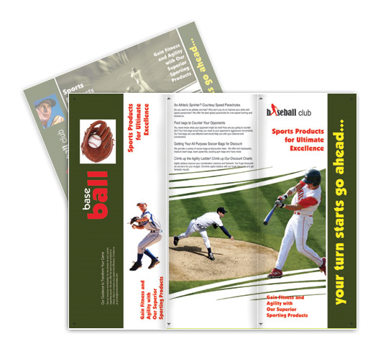
Flyers and ads …
Advertising is an effective way of communicating to large number of people in your community.
When you are preparing your advert or flyer, think carefully about what you want it to say.
Look at other flyer designs…perhaps another baseball club has a good template.
Use your branding.

Slide 26
Flyers and ads …
Here are some ideas to get you started:
Target audience – does your advert/flyer speak directly and clearly to the people you want to reach?
Focus – does it offer a single, central idea?
Visibility – will your advert stand out on a page or a screen?
Branding – is it distinct from your competitors? Many people make the mistake of seeing similarity as a benefit. Don’t be one of them!
Instead, do all you can to make your adverts/flyers different, while retaining your brand identity.
Layout – is the layout clean, logical and easy to read? Does the headline draw the reader into the copy? Does the copy stop the reader from moving on?

Slide 27
Flyers and ads …
Give the date, time, location and contact number plus any other vital information.
Remember to always sell the benefits in their best light – ‘selling the sizzle, not the sausage’.
Tell your customers what becoming involved with your club will do for them!
An advert/flyer should always answer the customer’s question – “But what does that mean to me”.
Include a ‘call to action’ that makes the reader ’do’ something.
Try to avoid including dates, prices etc when you are producing large volumes of marketing material as they quickly become out of date.
Avoid too much text; less is more!

Slide 28
Posters…
Posters advertising the coming season, Come and Try Day or a special event can be professionally printed and displayed throughout the community, keeping in mind your target market.
If you are advertising a junior Come and Try Day, fast food restaurants such as McDonald’s or Hungry Jacks will usually pin a poster on their noticeboard or window. Use the same principles of design mentioned earlier with flyers. Make them happy, colourful and clear.

Slide 29
Local media …
Through the production of press releases, the media offers you a cost effective method of promoting your club or an event you are running. If you have a story that is newsworthy and relevant to the local community, the media will allow you to promote this free to a large audience.
Many local newspapers will publish a regular contribution written by someone within your own club.
Make sure that you find out who the correct contact person is at your local paper and regularly keep in touch, invite them to events and nurture the relationship.

Slide 30
Local media …
Press Releases
Every press release you write should have a strong title. Focus on ‘firsts’ e.g. one of your club members is the first to qualify for a national event. As always avoid jargon.
Don’t waffle or try to set the scene, but get straight into your story.
Summarise who’s involved; What’s happened or is about to happen; Where and when the news took place or will take place; How events have unfolded so far, and why this is important.

Slide 31
Local media …
Follow up the first paragraph by filling in the details. The main things are to make sure you give the journalists all they need, and to make it as interesting as you can. Keep the sentence structure simple, explain complicated terms, and don’t use jargon. Avoid hype and self-congratulation and never make a claim you can’t back up. Remember that local media want a local angle. So think about how the story affects local people.
Give interesting quotes from the people involved. When quoting someone, use the style - he/she said: “This is great news for the whole community”.
Avoid lofty terms like “he commented”. Always provide full names and job titles, and if it’s not clear, explain what the person does.

Slide 32
Local media …
Photography breathes life into a story. Publications however receive a lot of photographs, so it’s essential that any photographs you supply:
Stand out from the crowd, and
Conform to the publication’s own style.
For maximum impact, consider spending some money on a photographer with media experience.

Slide 33
Local media …
Top tips when dealing with journalists
Do email press releases to journalists within the body of your email and not as an attachment.
Do put the press release headline (or a summary of it) in the subject box of your email.
Do follow up press releases with a telephone call to the individual emailed.
Do observe journalists’ busy times of the day and deadlines.

Slide 34
Local media …
Top tips when dealing with journalists
Don’t phone a journalist before you have fully thought through the idea or story you want to discuss.
• Don’t use email to ‘sell’ the story. Use the phone and follow up with an email.
• Don’t assume journalists will read your email. Always follow up with a phone call.
• Don’t talk to daily morning newspaper journalists after lunch unless it is absolutely critical e.g. informing them of a significant change in detail to your story.
• Don’t talk to daily afternoon newspaper journalists in the morning. They are likely to be on deadline from first thing until lunchtime.

Slide 35
Signs and banners …
A sign can be used for a lot more than just a way for people to find your clubrooms.
Although this is important, signs can also be an effective way for you to communicate important information about your club.
Whether it’s an upcoming event, tournament, or the key dates for registration, signs are an undeniably important way of promoting your club and communicating to the public.

Slide 36
Signs and banners …
For your sign to be effective it needs to be visible either for people walking or driving.
Include a header, which will grab the readers’ attention and draw them to the sign.
Below the header, use the space to communicate essential information accurately and in full.
The reader should be able to easily read and interpret the wording while answering all their likely questions.

Slide 37
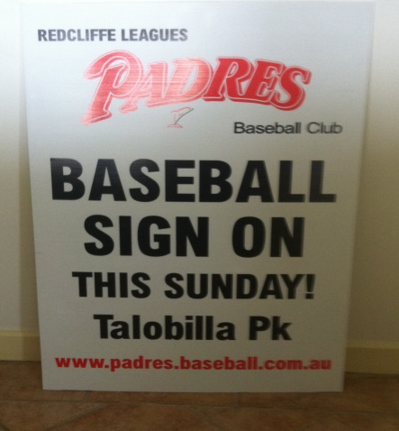
Signs and banners …
To ensure not too much information is crammed onto the sign, provide a website address for the reader to find out more information about what you’re communicating.
It is vital that you tell the reader what they need to do to contact you such as a phone number or email address.

Slide 38
Signs and banners …
Some examples of signs and banners that you can use are:
Sign on street at entrance to park
Sign on clubhouse
Corflute signs temporarily around community before Sign-On (check local council for by-laws regarding this practice)
Banners at council banner sites, shopping centres, train stations, busy roads on a friendly residents’ fence. Always check local regulations and obtain permission.

Slide 39
Direct mailout ….
Whether you’re promoting an event or maintaining strong relationships with your existing members, direct mail is a great way to make a more personal approach.
Direct mail can be sent via the MyClub database which includes current and past members of your club.

Slide 40
Direct mailout …
Name and address – accuracy is everything, as there’s nothing more irritating than receiving a letter with your name or salutation incorrect.
Headline – use the headline to grab the recipient’s attention, and to encourage them to read on.
Content – remain focused on one key message, and avoid jargon. Steer clear of long sentences and use active sentences rather than passive ones whenever possible e.g. ‘You will see…’ not ‘You will be shown…’.
If you produce your document in Microsoft Word, carry out a spelling and grammar check.

Slide 41
Direct mailout …
Call to action – be clear what you want the reader to do next. If you want them to call, print the number clearly, in bold perhaps, with times when the phone is manned. If you want a coupon or reply slip returned, keep it simple and enclose a pre-paid envelope. Also, give a deadline by which people should respond.
Envelope - an anonymous envelope might sit unopened, or even be thrown straight in the bin, so it’s often worthwhile to put a message on the outside of the envelope to entice the recipient to open it.
Direct mailing has been somewhat superseded by social media but can be a useful, more formal way of contacting people.

Slide 42
Engage the local community…
It is important that your club becomes a hub of your local community. What would be the effect of your club not existing? If there is no effect, then you need to make your club more relevant to locals.
The first step is to develop a community engagement program. Link your club to other parts of the community such as hospitals, emergency services, schools and housing estates. Make the most of your facilities and share them with your partners during quiet times.
Utilise the expertise in your community such as legal and financial professionals. They will also benefit if there is a successful club in the local area.

Slide 43
Engage local businesses
Look at your club as a large network of people which local businesses can promote its products and services to.
Sell your club and illustrate how a business can be more visible in the community by being linked to your club.

Slide 44
Be a welcoming club …
How are new members treated when they join your club?
Are they made to feel welcome and shown around your facilities?
This is where the people within your club come to the fore.
No amount of promotional material can disguise an unfriendly club.
Think about a buddy system, where each new member is paired up with an experienced one.

Slide 45
Are you a family friendly club?
How do your clubrooms and facilities look from a new member, parent or child’s point of view? Is it a place where you would take your family to? Are there things for children to do such as a play area?
Think about what music you have playing and what you put on TV within your clubrooms. Are they what most members would want to listen to and watch?
Is the entrance to the clubrooms easily found and well lit. Are there clear signs that tell people they are at your club?

Slide 46
Look after your members…
If your new members are silver, then your existing members are gold. It’s amazing to think that if you retain 90 percent of your members per year, you will have lost more than a third in four years.
Happy members will tell their friends and family how great your club is. This is the most effective type of promotion, and best of all it’s free! Try to show each existing member how you value them and get them involved.

Slide 47
Make the most of your people …
Your current members, and their skills and knowledge, are probably the most valuable asset your club has. They act as ambassadors and have a great influence on the atmosphere and peoples first impression of your club.
Don’t focus just on who can help, but also what they can they do. Learn about the specific skills of your members. Have they got skills in IT or carpentry, or can they work behind the bar?
Don’t ask people to do too much. Unless they ask to do more, limit the amount of time they spend each week to two hours.
Finally, don’t forget that your volunteers need managing. Volunteers, like any employees, will respond better if they feel what they are doing is being valued.

